Slide 1
Programming with C and Python for Newbies
Day 4: User input and Validation

Slide 2
User input and validation
In programming, its often necessary to take input from the user.
We then perform some operations on the user input
But most times the user might give us a wrong input , so there’s need to validate it so our code doesn’t breakdown with an error

Slide 3
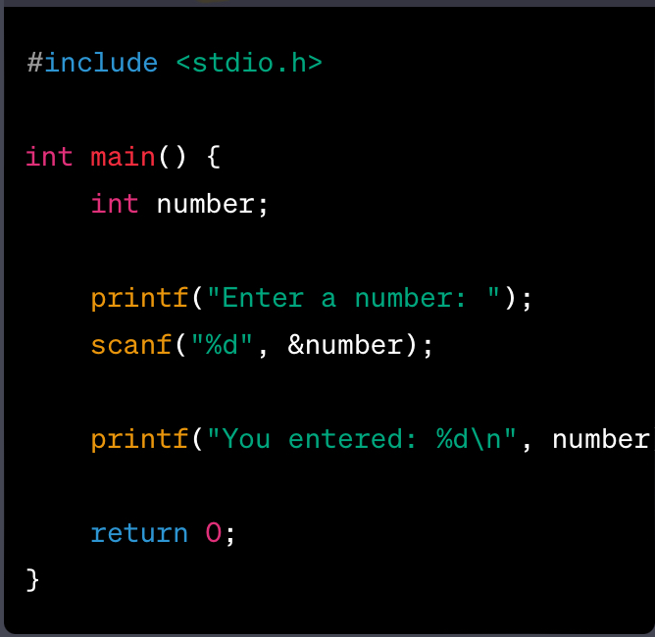
Syntax
We use the scanf() function in C
to get input from the user

